Slide 2
WELCOME
TO
ENGLISH-CLASS.

Slide 3
INTRODUCTION

Slide 4
Class: - Nine
Sub: English 1st Paper.
Unit: One.
Lesson: 4
Time- 40 minutes.
Date:

Slide 5
By the end of the lesson you will have:
Described pictures of the preparation for mela.
Planned how to organize a Bais
hakhi mela at your school.
Talked about how to organize a mela.

Slide 6
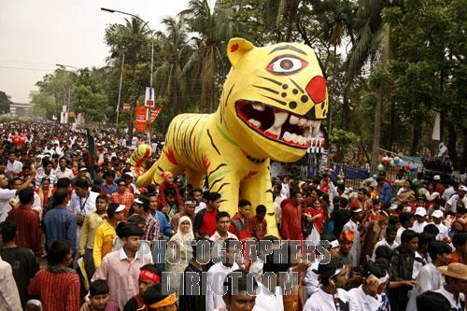
What can you see in the picture ?

Slide 7
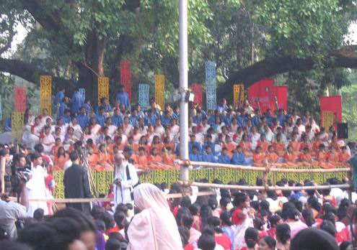
What can you see in the picture.

Slide 9
So, today our topic is-
PAHELA BAISHAKH

Slide 10
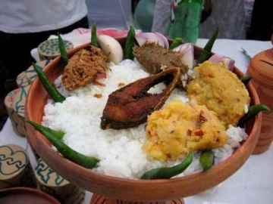
Traditional food of pahela baishakh.

Slide 11
Pronouciation
The day will be celebrated with traditional festivities across the country.

Slide 12
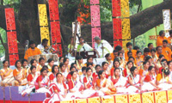
The day is a public holiday.

Slide 13
The day’s
first program will begin at
dawn at
Ramna Batamul.

Slide 14
A large number of people wearing traditional dresses are expected to attend the programme.

Slide 15
Bangladesh Television
will telecast
live program from 6
in the morning.

Slide 16
একটি ভিডিও চিত্র দেখি

Slide 17
Shilpakala Academy will organize a cultural function on the Academy premises.

Slide 18
Vocabulary
Banners

Slide 19
Celebrate

Slide 20
Festoons

Slide 21
Traders

Slide 22
Shopkeeper

Slide 23
IFA-Fine
Arts
Institute of Dhaka
University.

Slide 24
Bangladesh National Museum.

Slide 25
Group work:
How to organize a baishakhi mela at your school.

Slide 26
EVALUATION:
The world “traditional” means-
When BTV telecast program from?
Where do the first program held?

Slide 27
HOME WORK
You are going to celebrate the Bangla New Year. Now write about your feelings on the occasion.

Slide 28
THANK YOU

